Slide 1
Banks and non Bank Entities
Cooperation / Coopetition
August 6, 2010
A presentation by:
Vivek Nayak
COO
Avenues India Pvt. Ltd.

Slide 2
Role of Banks?
Provide good banking services
Make money by moving money
Bank the unbanked …. ABCDs.
Can technology help?
How far should a Bank go to grow?

Slide 3

Stick to the knitting…

Slide 4
Show me the money!
How to look for new revenue models?
  Look outside and partner innovators
  Create successful business models through partnership!

Slide 5
Cooperate
Non Bank Services Company (NBSC)
  Identifies Market Gaps
  Creates Innovative Solutions
  Helps Banks maximize synergies
  Opens up new revenue streams
3Ms – “Money Moving Machines” for the banks

Slide 6





How to swing new business
Hotel Group
😐
Aggressive
new bank
Current Bank
Relationship

Slide 7


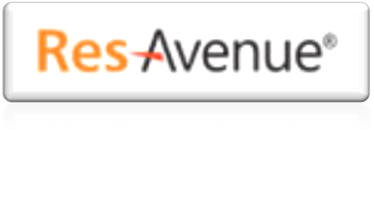
3Ms in action
😐
Aggressive
new bank
Hotel Group
Innovative new
solution from
3M Co. Avenues

Slide 8
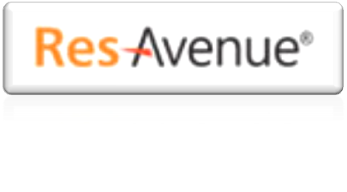




Complete hotel room booking engine with an online payment gateway attached.
Room inventory distribution tools connects to multiple Global Distribution Systems and IDS.
Circle of Influence
Without ResAvenue
Circle of Influence
After ResAvenue
Customers from across the globe
Local Markets
World Wide Travel Agents
Travel Associates
Returning customers
Returning
customers
Global Corporate Entities
Hotel Group
Hotel Group

Slide 9
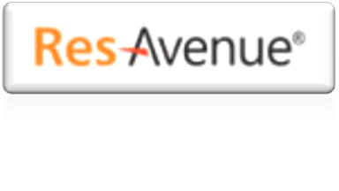


Opportunity for the new bank
All Global PG funds settled in
hotel’s account in new bank
Aggressive
new bank
😐
Hotel Group
Bank deepens the relationship with hotel by providing other banking services:
  salary accounts, overdraft, loans, etc

Slide 10



Step Two: More Revenue Generation
Millions of bank customers using
Internet Banking and Debit Cards
Customers book rooms and pay through their bank accounts
Negotiates special deals from Hotel Group and offers to its customers
Hotel Group
Debits customer’s account in the bank and pays hotel’s account in the same bank
Aggressive
new bank

Slide 11

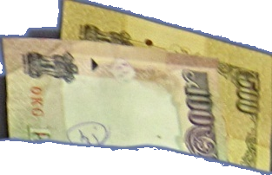
Banks move funds from left pocket to right pocket
Earn a percentage of value of funds moved as revenue
%

Slide 12






`win-win’ for all
Hotel Group
Aggressive
new bank

Slide 13
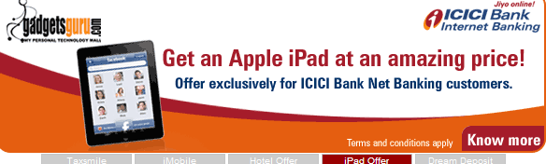
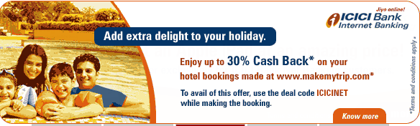
Side effects
New customers will want to open an account in the bank that offers extra value adds

Slide 14
Broadening the Scope
This is just one company, Avenues.
There are 100s of other such small companies
creating innovative new solutions.
There are many other sectors where opportunities lie:
  Events, Entertainment, Sports, Bills, Insurance, Govt.
More solutions =
more value for the bank customer =
more movement of money =
more revenue for the banks

Slide 15
Cooperation or Competition?

Slide 16
Example of the dangers
Gets just 15% of Revenue
MOBILE
VAS
COMPANIES
Receives dues after 6 months
Transparency on numbers?

Slide 17

Cooperation or Coopetition?
Understand the role of each part
Maintain balance in revenue share
Nurture the spirit of innovation
Preserve mutual respect & work together.
“If we are together, nothing is impossible.
If we are divided, all will fail.”

Slide 18
Thank you

